Slide 1
MERRY DECEMBER
in Primary School Radenci

Slide 2
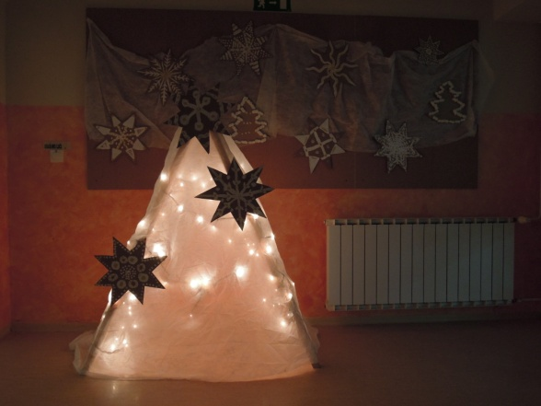
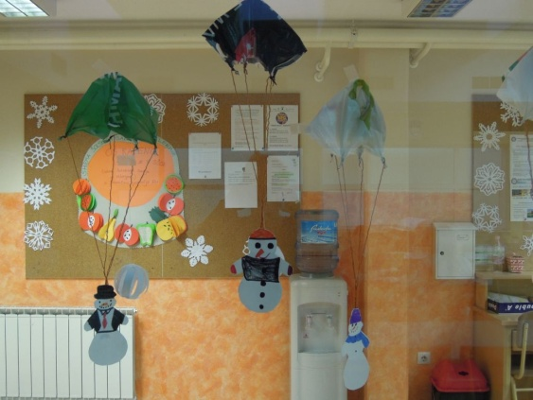
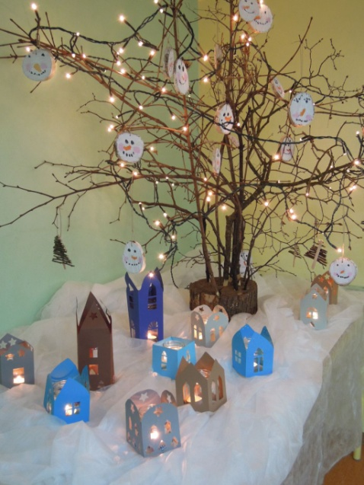
Decorating the school

Slide 3
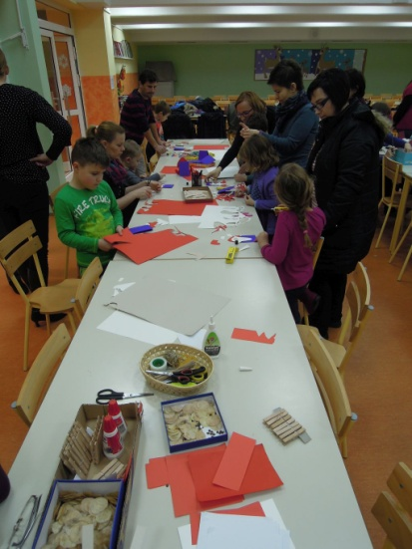
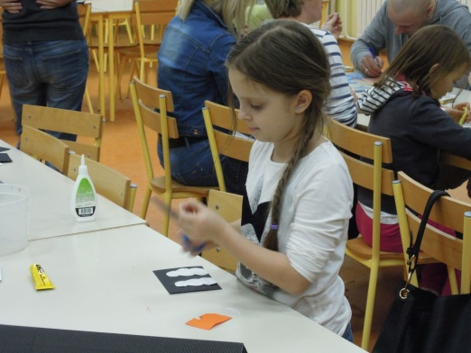
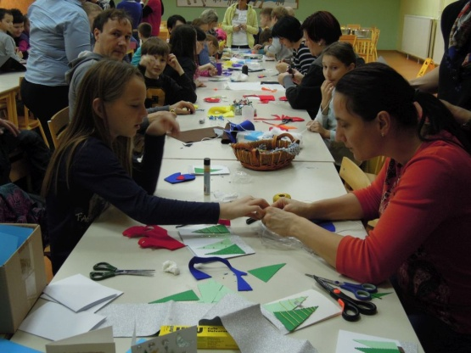
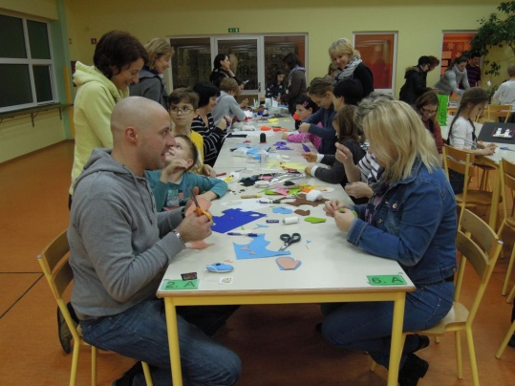
Christmas Workshops
for parents and pupils of first to fifth class

Slide 4
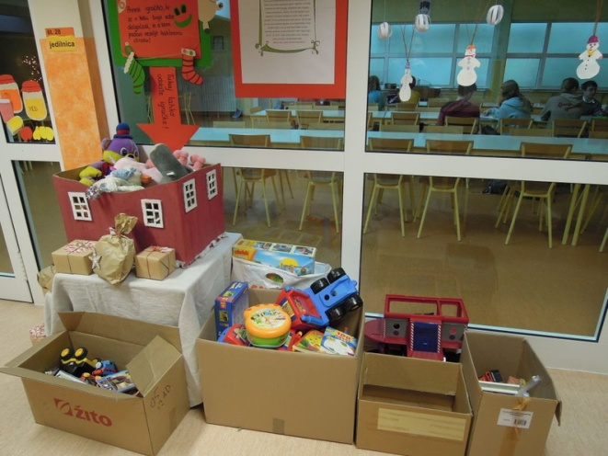
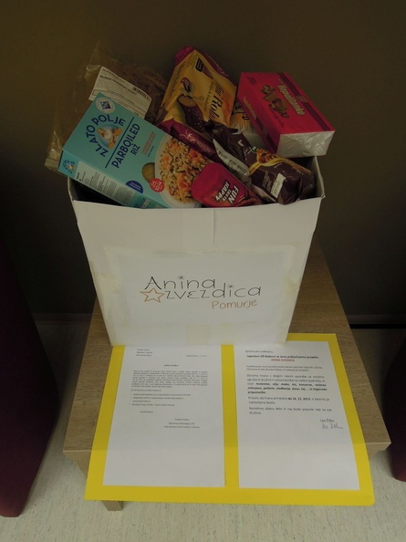
Charity
PUPILS:
Collecting toys for the families who can not efford to buy toys for their children.
TEACHERS:
Collecting food for the families in need in our region.

Slide 5
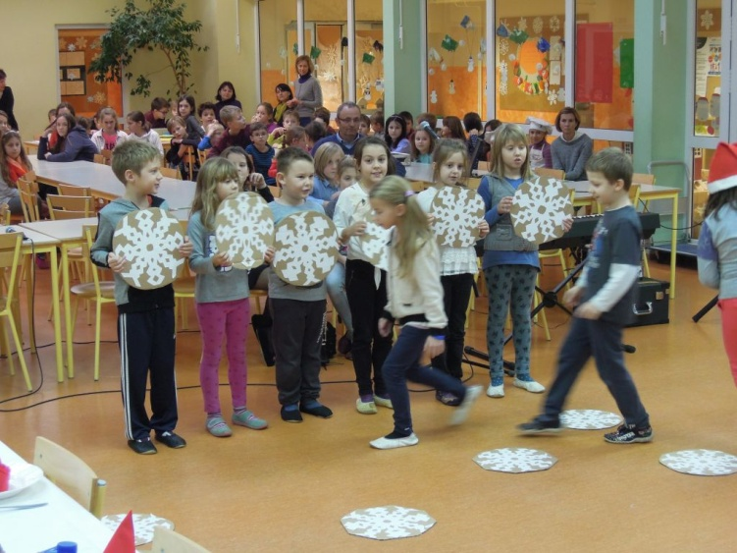
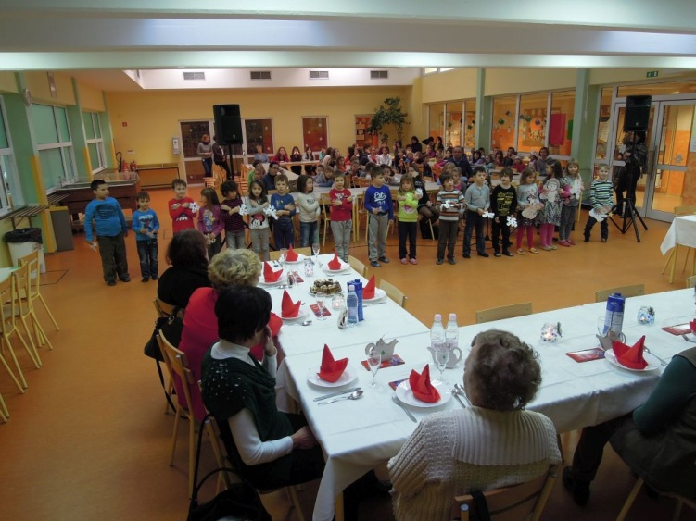
Celebrating Christmas and New year with retired workers of our school

Slide 6
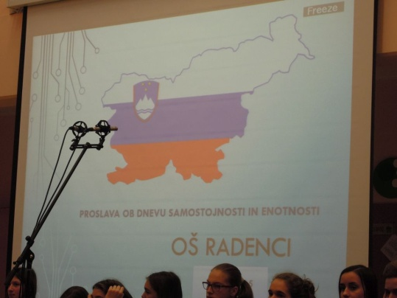
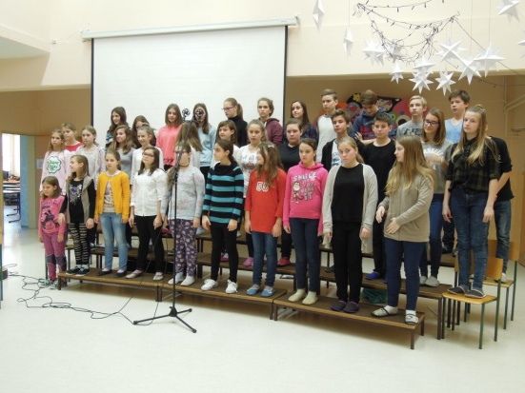
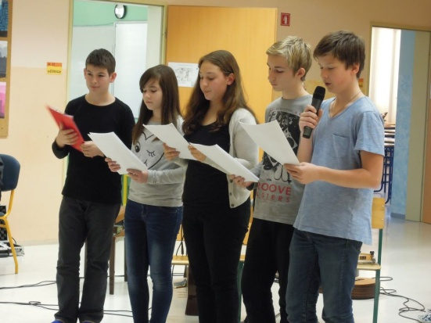
Celebrating Independence and Unity Day
Independence and Unity Day is a Slovenian national holiday that occurs on every 26 December to commemorate the official proclamation of the Slovenian independence referendum on 26 December 1990.

Slide 7
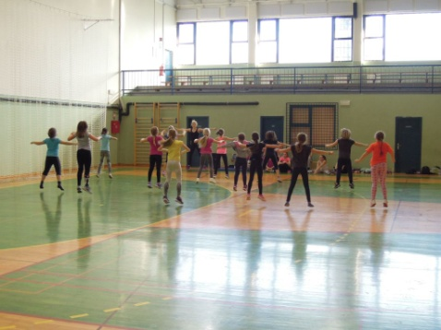
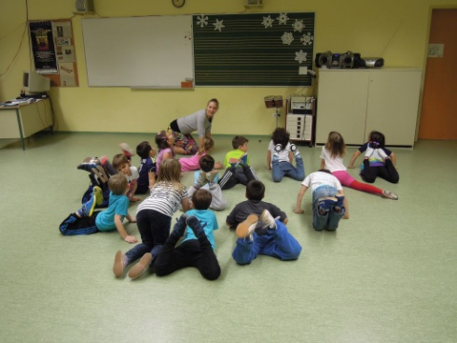
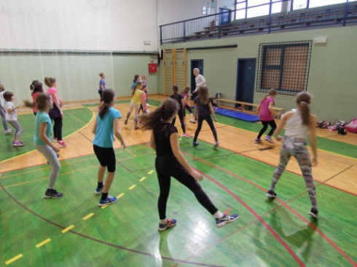
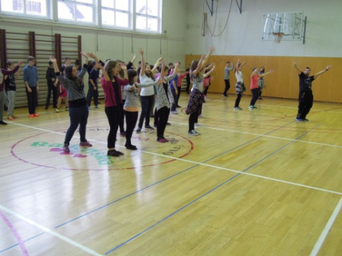
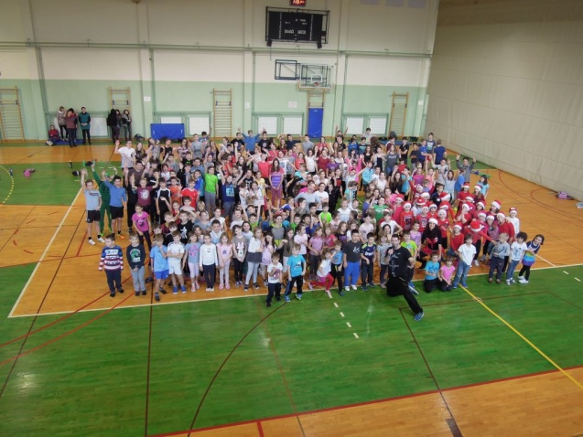
A Day for Dance
Dancing hip hop, disco dance and breakdance with Dance School Zeko.

Slide 8
HAPPY NEW YEAR from pupils and teachers of Primary school Radenci
Music:
Macy Gray -Winter Wonderland

