Slide 1
OUR TOWN RADENCI
RADENCI - A SMALL TOWN IN SLOVENIA
Low-lying agricultural region in the north-east of Slovenia

Slide 2
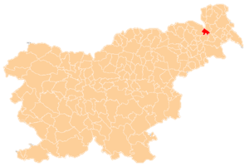
Position of Radenci
Radenci lies near the road Gornja Radgona-Murska Sobota. Radenci is well known, because of its popular health resort and mineral water called Radenska which is filled in Radenci.
Radenci lies on the right side of the river Mura.

Slide 3
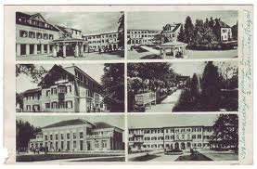
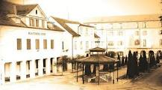
HISTORY
Radenci was first mentioned in 1436 as a resort, but became famous in the 19th century.
In 1833 Karl Henn discovered springs of mineral water and in 1869 built the first filling; health resort opened in 1882.
Development of spas and the whole place was built in 1890 has accelerated the rail above Radgona - Ljutomer.

Slide 4
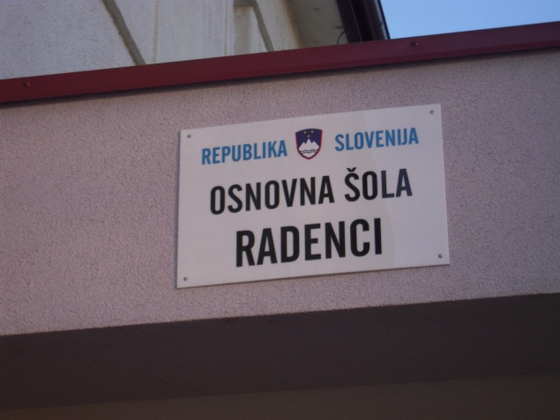
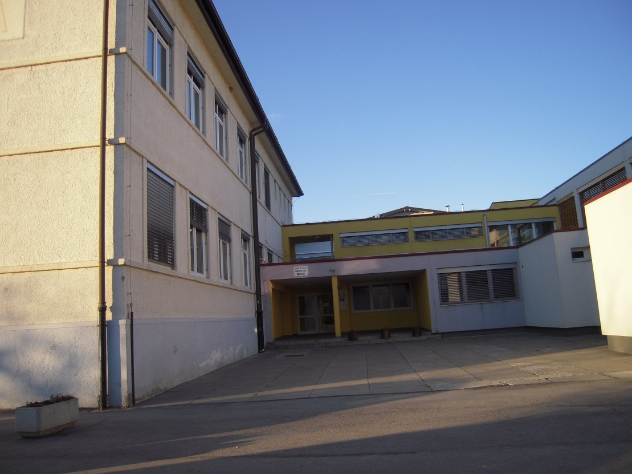
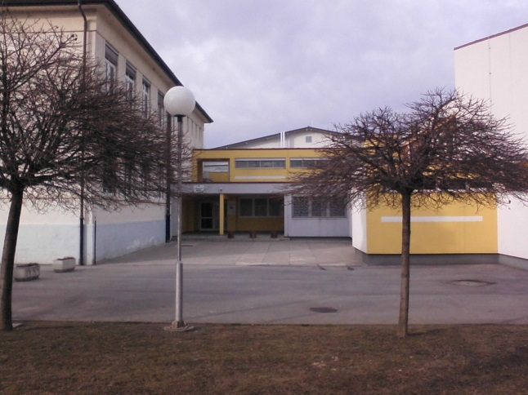
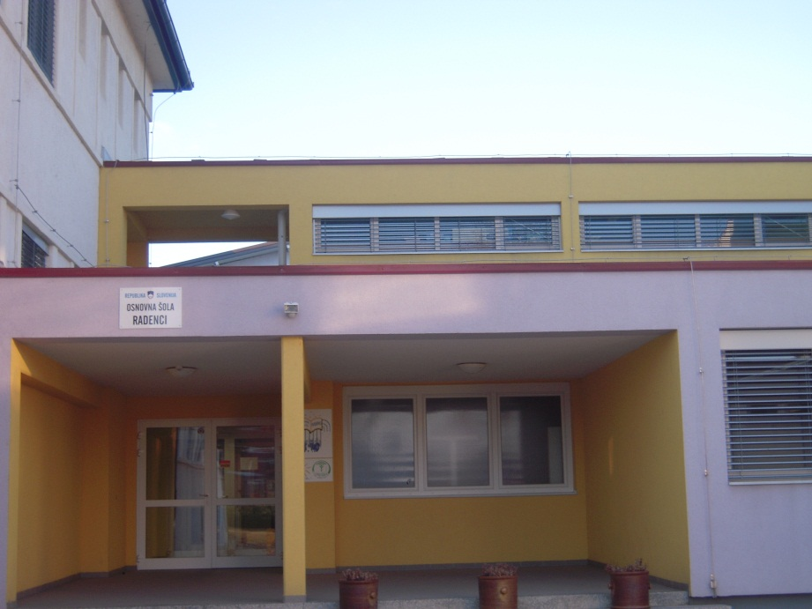
OUR SCHOOL :
website

Slide 5
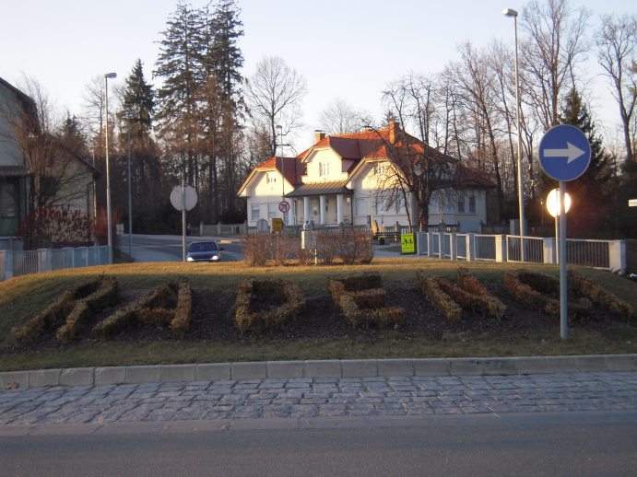
Villages
There are 4 villages which lie near Radenci:
1. Šratovci 2. Boračeva 3. Turjanci 4. Rihtarovci

Slide 6
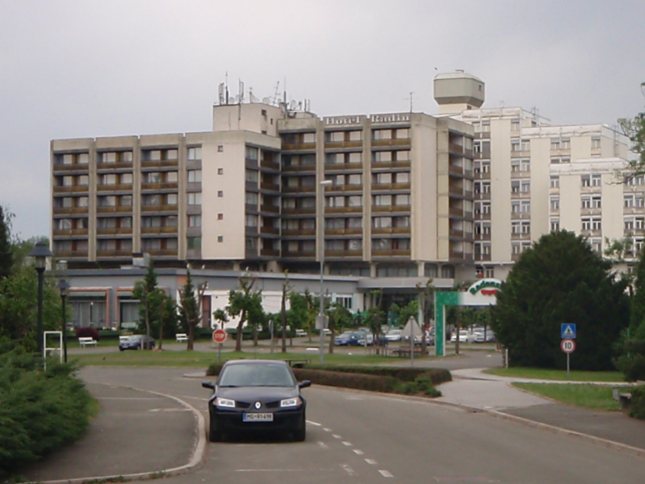
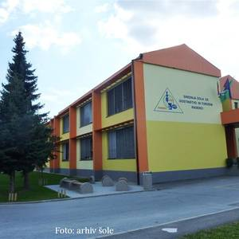
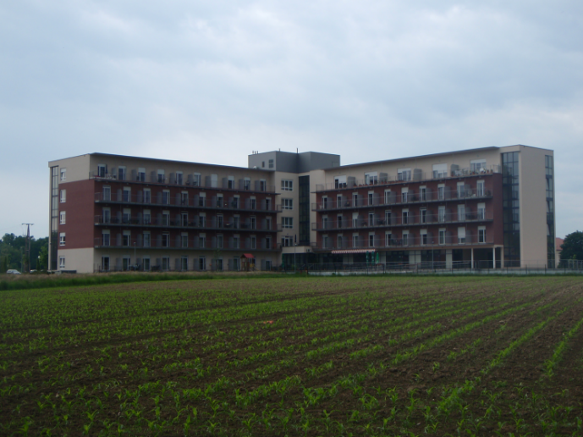
Buildings
School
Kindergarden
Bank
Post
Health center
Middle school
Retirement Home

Slide 7
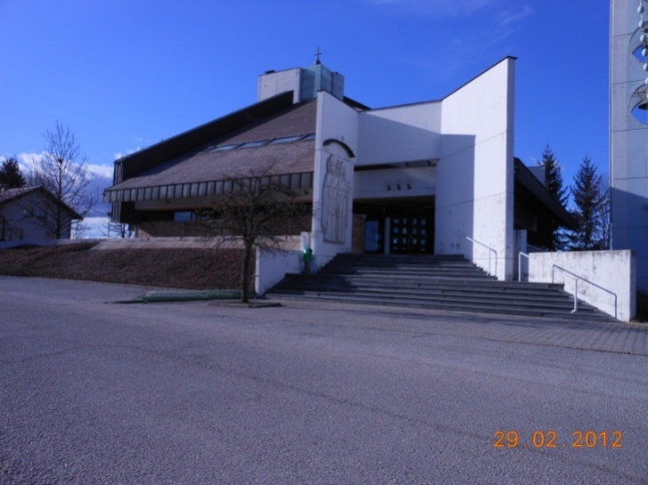
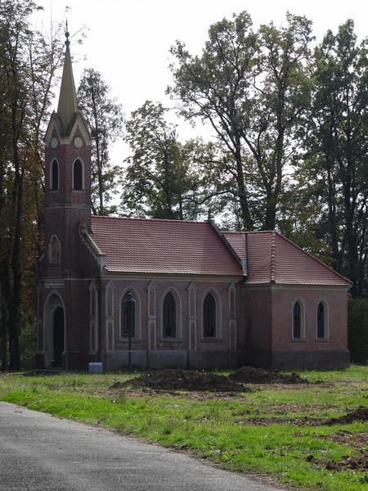
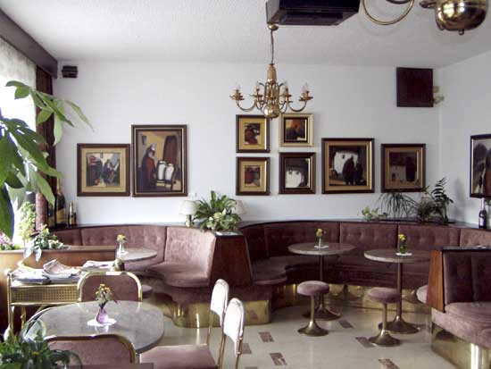
Cafe
Church
Chapel

Slide 8
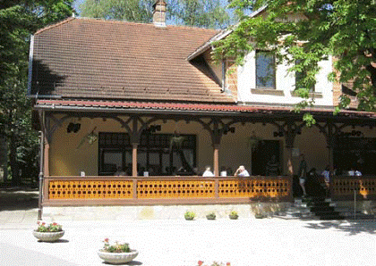
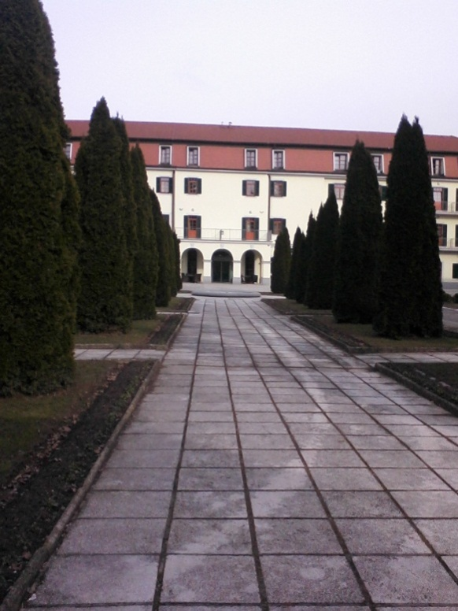
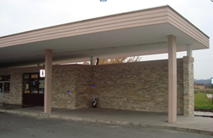
Restaurants
Bus station
Hotel

Slide 9
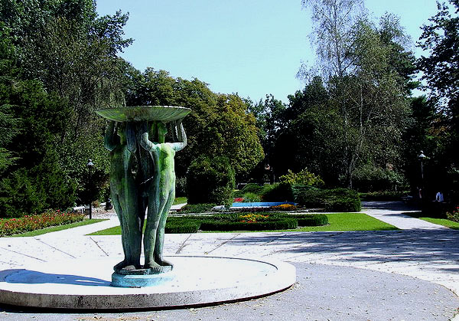
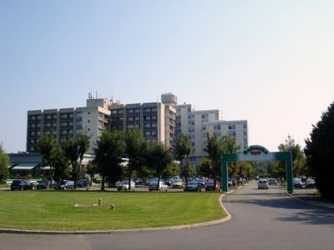
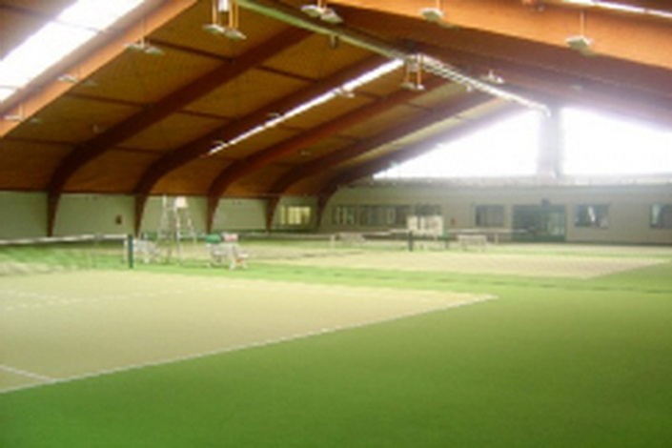
Blocks of flats
Shops
Casino
Health resort
Park
Sports places

Slide 10
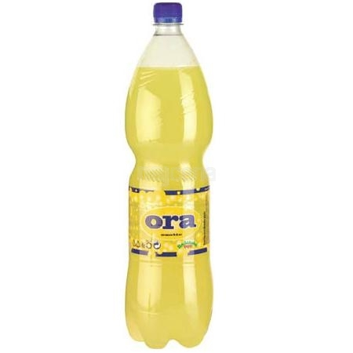
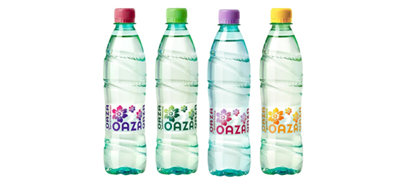
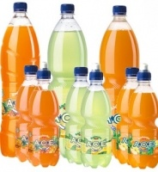
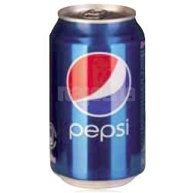
Radenska
Radenska is a name of mineral water which springs in Radenci. There are nine different thermal springs. Radenska is the most famous mineral water and the best sportsmen and sportswomen are drinking it. Here are some products: Pepsi, Radenska classic, Radenska light, Radenska naturelle, Ora, ACE, Oaza.

Slide 11
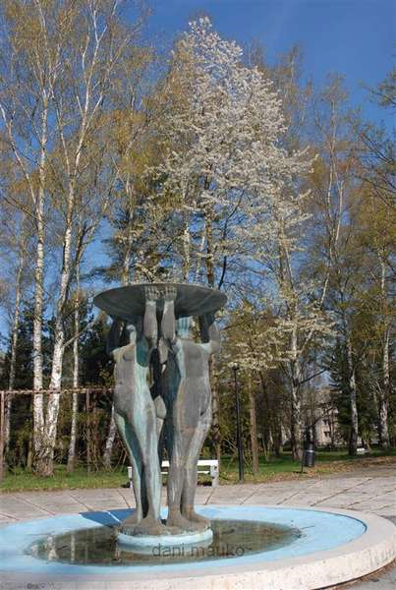
POPULATION
In Radenci live about 2162 people.
Most of them work in other bigger towns, and also in Mineral water company, named Radenska.
People in Radenci are friendly and a lot of them also work in tourism.

Slide 12
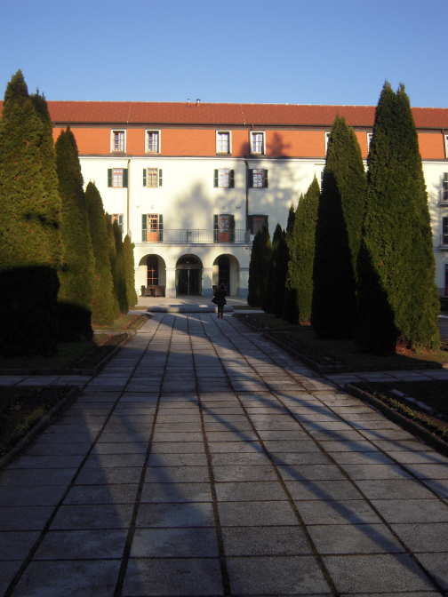
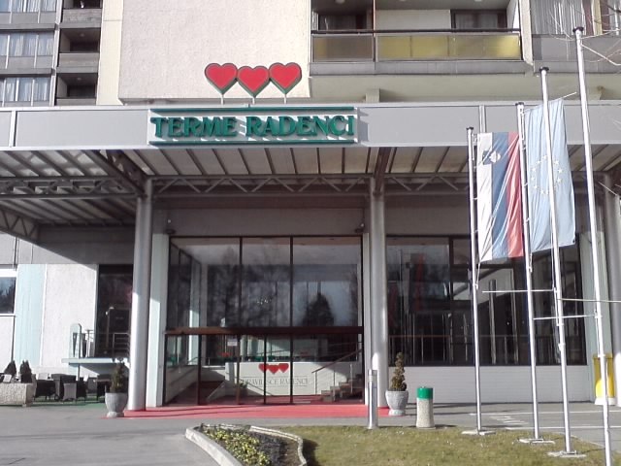
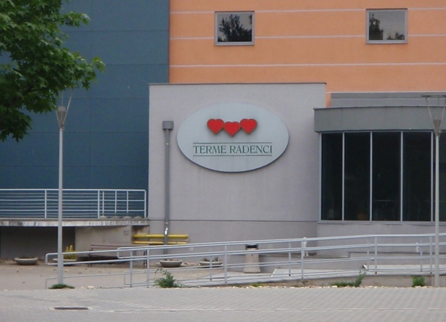
Thermal spa in Radenci:
One of the oldest health resorts in Slovenia.
Spa resort has thermal indoor and outdoor pools.
There is an Olympic pool inside with cold water.
The other two pools have warm water and they are connected.
HEALTH RESORT RADENCI

Slide 13
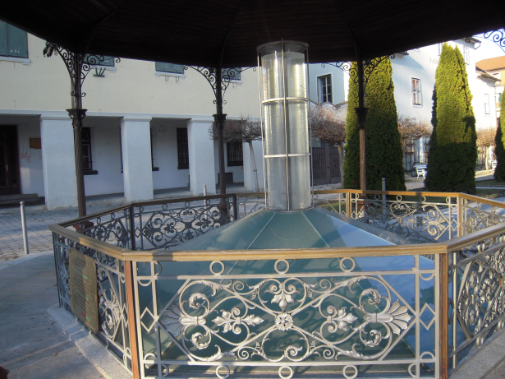
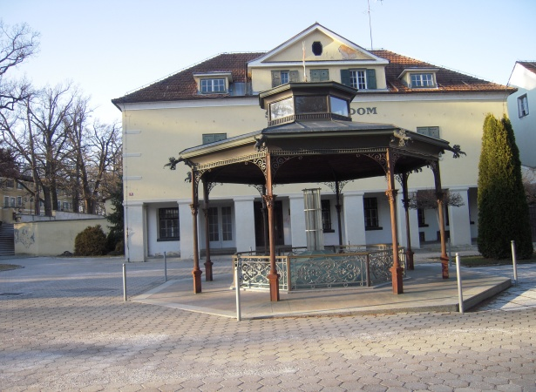
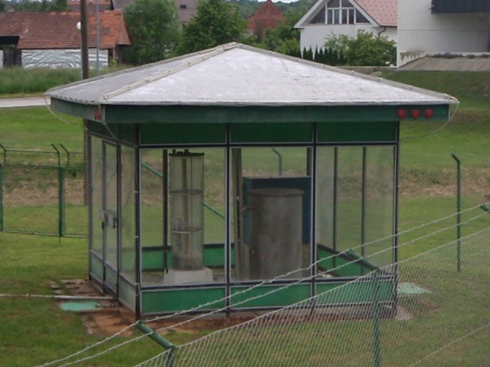
Now in Radenci exploit nine mineral water springs, with an average temperature of 12 - 16 ° C, which provided a basic spa and health tourism, which is carried out in the spa Radenci.

Slide 14
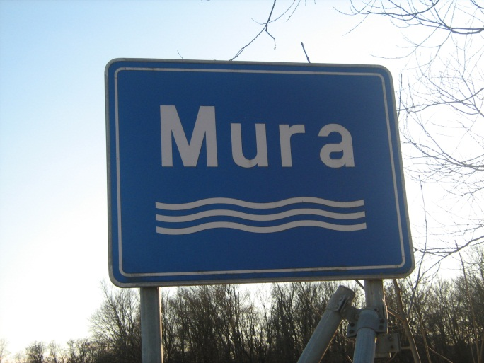
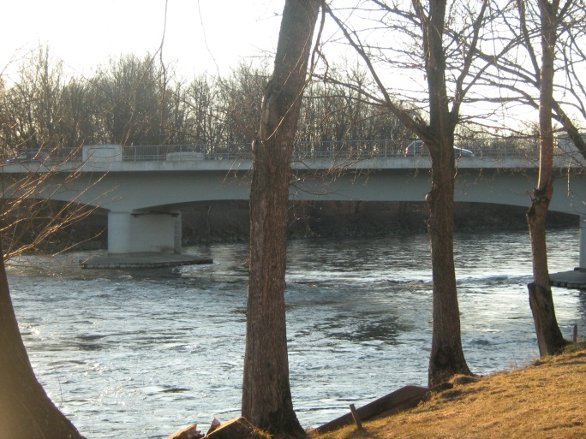
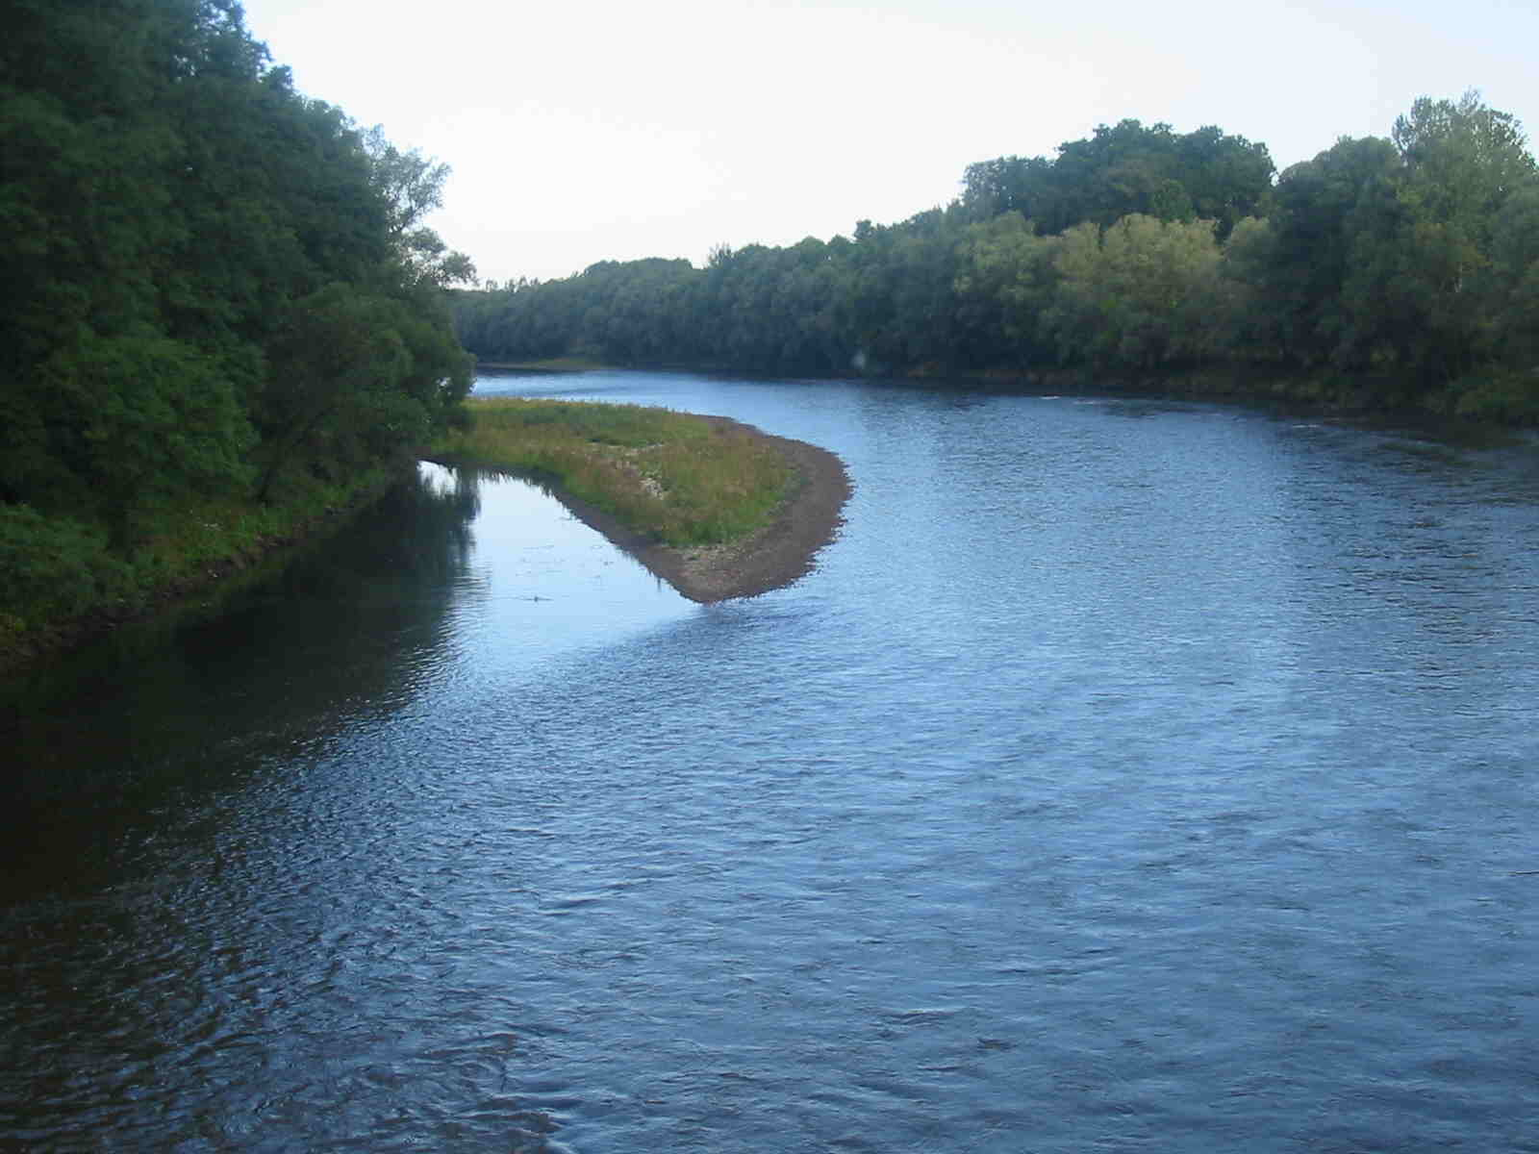
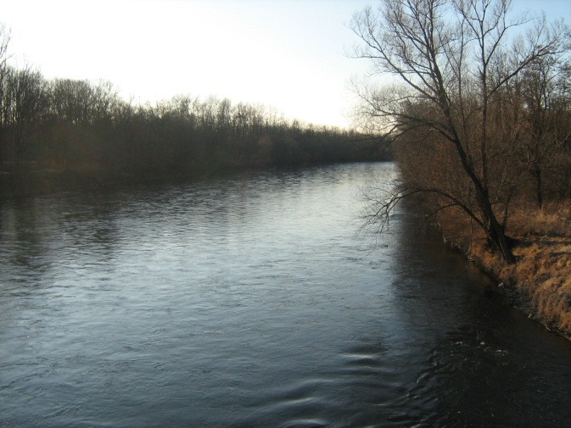
WHY PEOPLE COME TO RADENCI? Famous for its mild climate: it gets more than 250 sunny days a year. People come in Radenci to relax and get well.

Slide 15
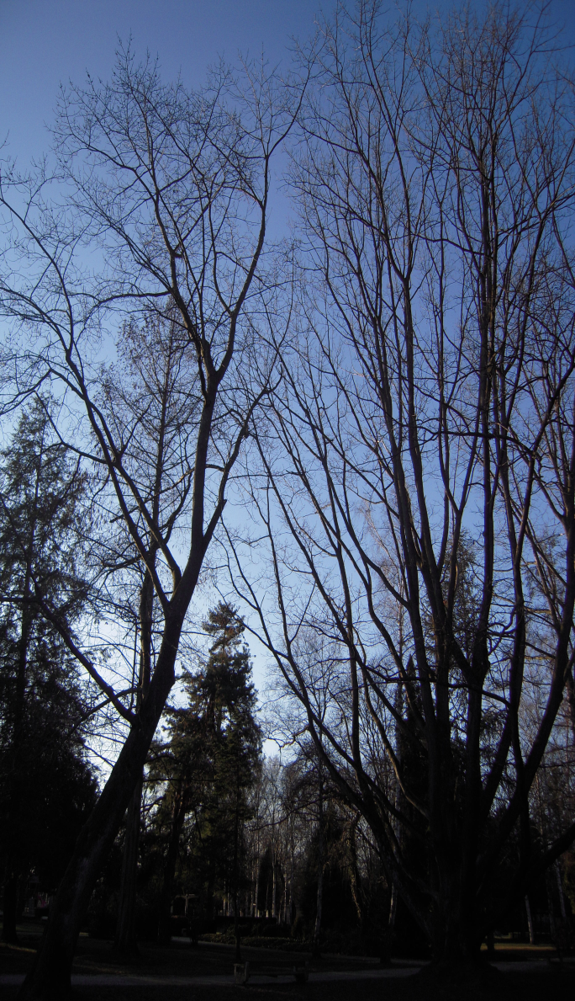
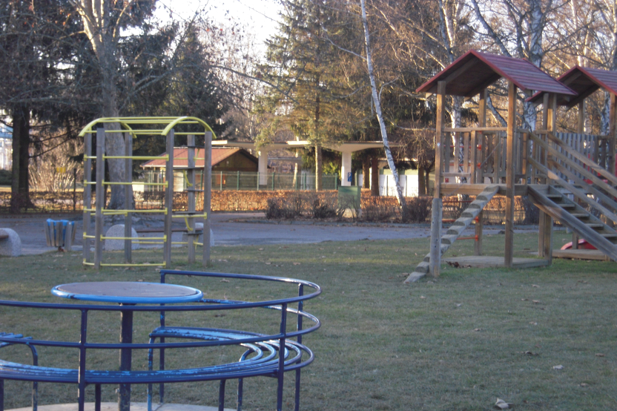
Park in Radenci is large and it has very old trees. In year 2010 the majority of these trees was destroyed by a storm. In the Park is the Chapel of Saint Ana

Slide 16
Three Hearts Marathon-running competition
one of Slovenia's most popular running events
held annually in mid-May
people can run 42, 21, 10 and 5,5 km
since 1981

